Slide 1

PROJECT ON
HR Analytics

Slide 2

Understanding Dataset
Combine two different datasets in Excel (HR1 & HR2)
Remove Duplicates & Null values
Change the formatting of necessary columns.
Change Case - Lower/Upper/Proper.
Trim the unwanted spaces.
Find and Replace.
Conditional Formatting using power query.

Slide 3
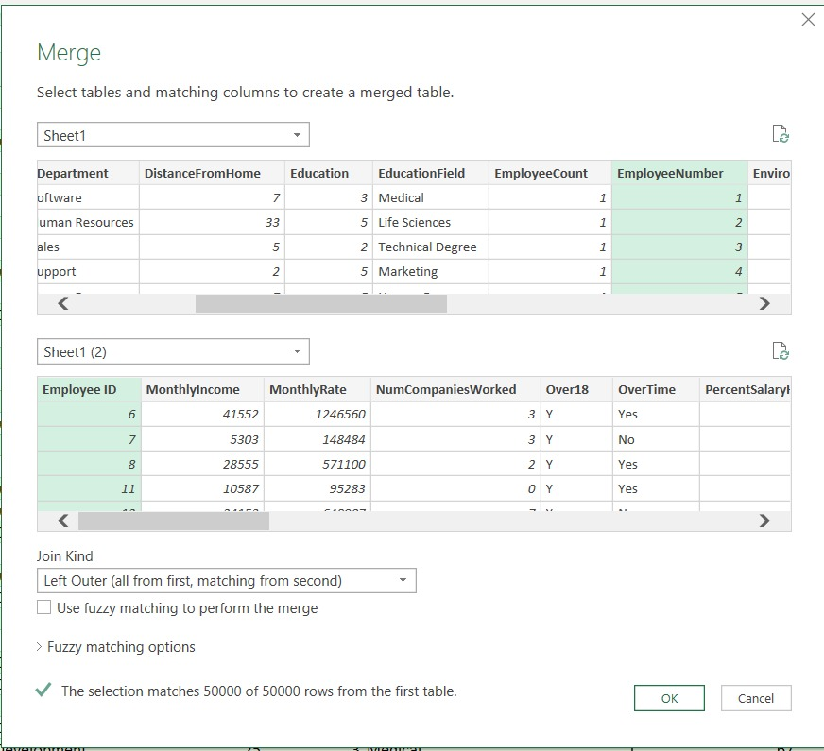
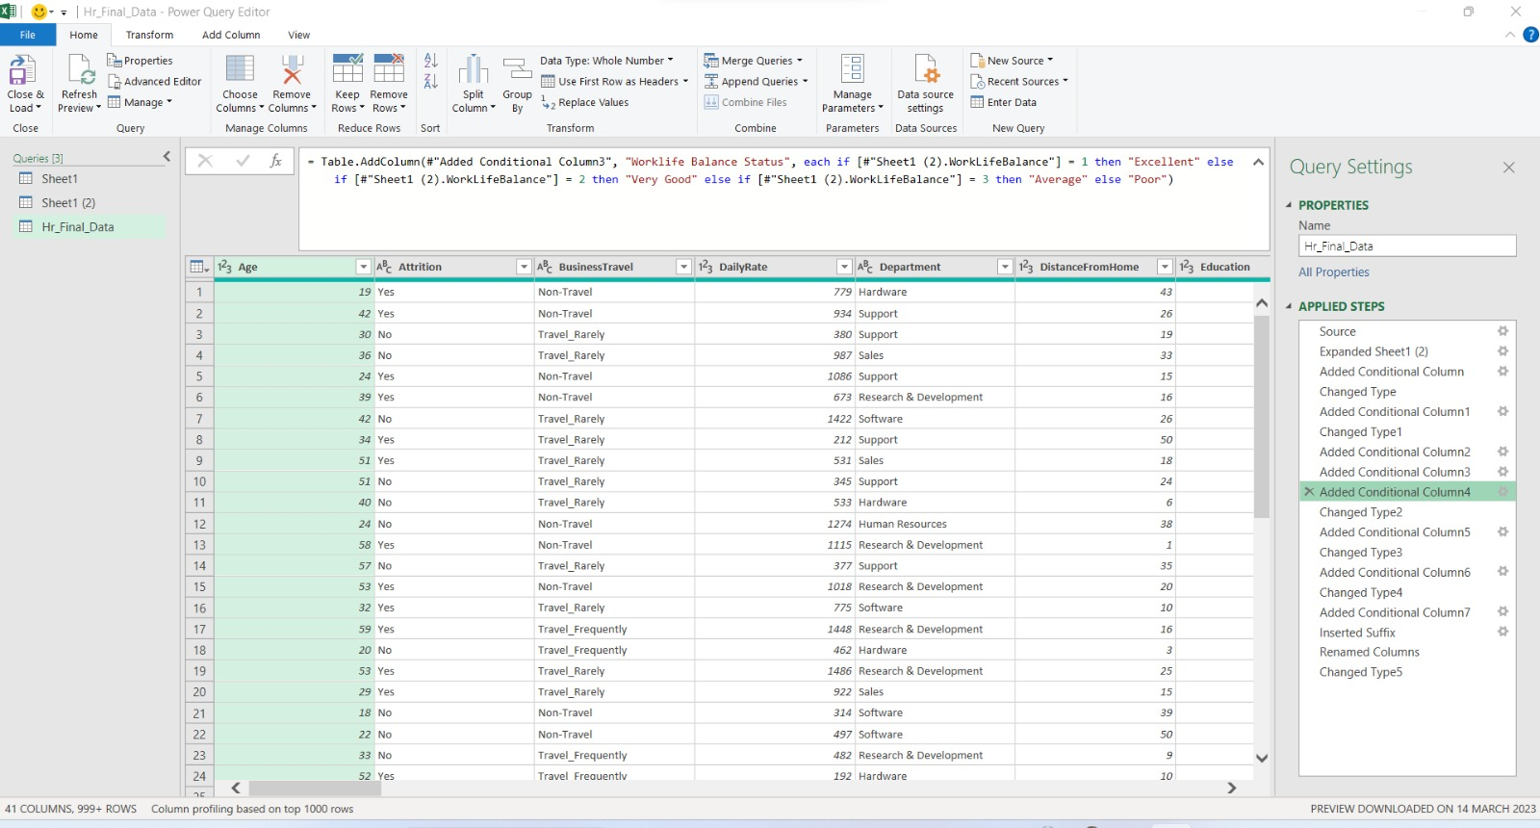
Merging two different datasets in Excel (HR1 & HR2)
Forming new columns as per KPI's requirements using Power Query.

Slide 4


Implementation of KPI's
Average Attrition rate for all Departments
Average Hourly rate of Male Research Scientist
Attrition rate Vs Monthly income stats
Average working years for each Department
Job Role Vs Work life balance
Attrition rate Vs Year since last promotion relation

Slide 5
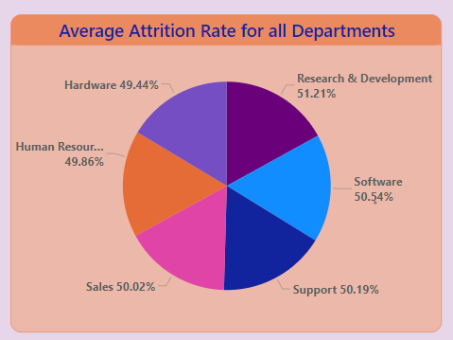
KPI 1: Average Attrition rate for all Departments
Insights :
Here, values are shown as percentage of Departments.
Majority of the employees are from the Software department and R&D department has the highest attrition rate of 50.54 % and 51.21 % .
Hardware department has lowest attrition rate of 49 % with the count of 4039 employees.

Slide 6
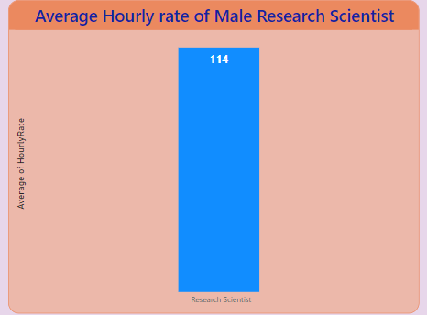
KPI 2: Average Hourly rate of Male Research Scientist
Insights :
Average Hourly rate of Male Research Scientist is 114 out of 115.16.
The highest average hourly rate is 115.38 of Sales Executive department while Developers has lowest average hourly rate of 114.18.

Slide 7
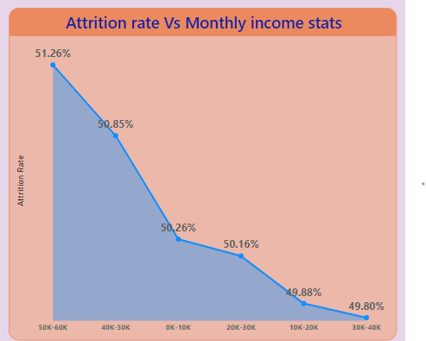
KPI 3: Attrition rate Vs Monthly income stats
Insights :
Here, values are shown as percentage & count of attrition vs monthly income.
It is observed that Maximum employee 15025 out of 50000 falls under the salary range of 50k - 60k and has highest attrition rate.
The salary range between 30-40k has the lowest attrition rate.

Slide 8
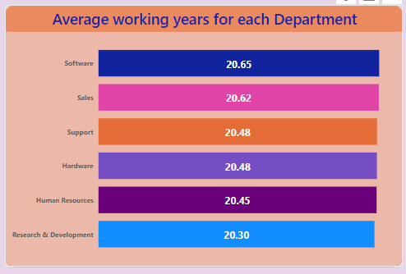
KPI 4: Average working years for each Department
Insights :
Here, values are shown as Average working years for each Department.
It is observed that Average working year of employees is highest in the Software department 20.65 Years
Lowest Average working Year for Research and development Department is 20.30 years.

Slide 9
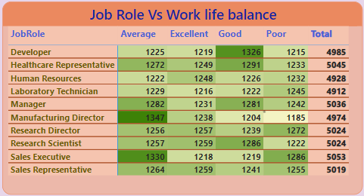
KPI 5: Job Role Vs Work life balance
Insights :
Sales executives have the lowest work-life balance rating.
Research scientists have the highest work-life balance rating.
Manufacturing Director have a highest Average work-life balance rating.

Slide 10
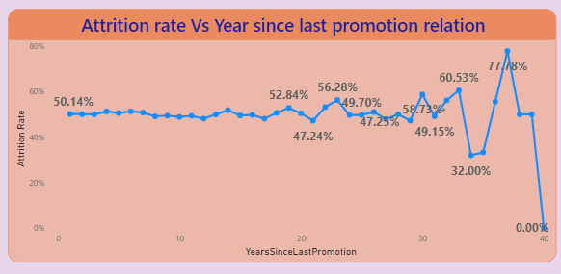
KPI 6: Attrition rate Vs Year since last promotion relation
Insights :
Employees in the 30-40 range of last year's promotion had a higher attrition rate.
Employees who received a promotion in the past year had a significantly higher attrition rate than those who did not.
Employees who received a promotion in the past year and had not yet reached a year since their last promotion had the lowest attrition rate.

Slide 11
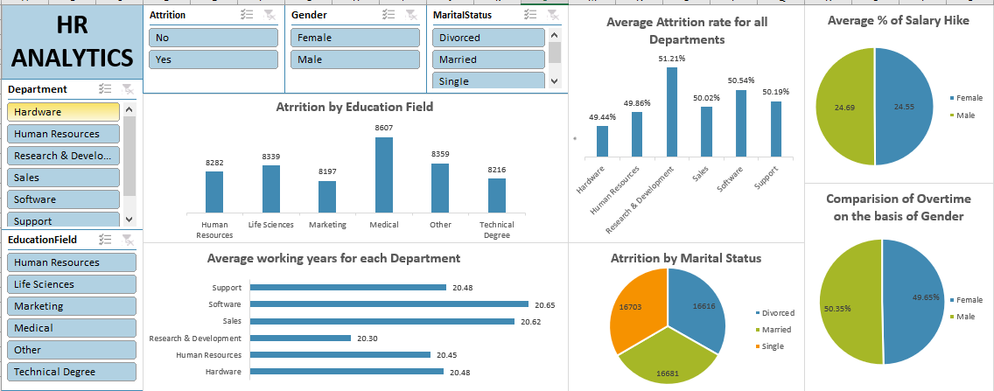
Dashboard in Excel

Slide 12
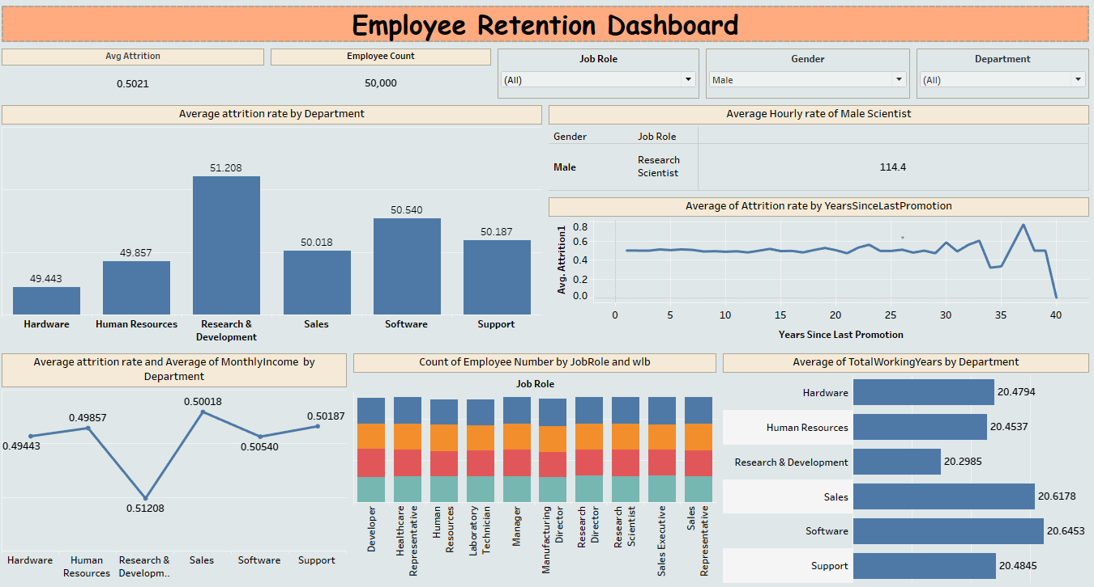
Dashboard in Tableau

Slide 13
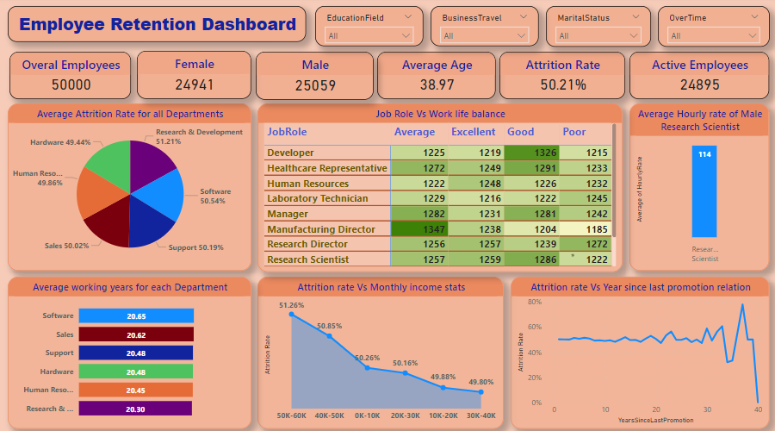
Dashboard in Power BI

Slide 14


